Slide 1
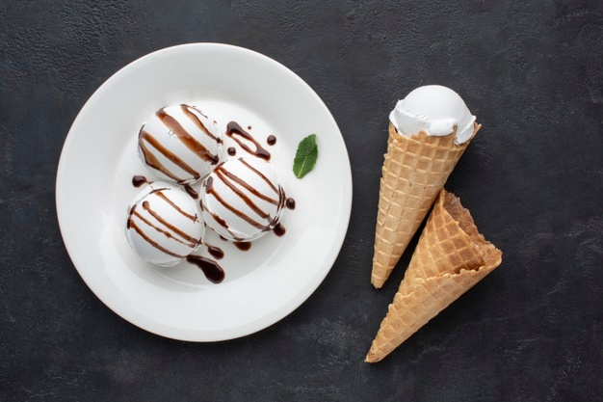
QR-Yummy: Class Presentation
Team-3
Zubair Ahmed Baig Mogal
Soumyadip Chatterjee
Gayathri Raj Patel
Chitra Lekha Yatham
Robert Aliberti
Divyaa Mohankumar

Slide 2
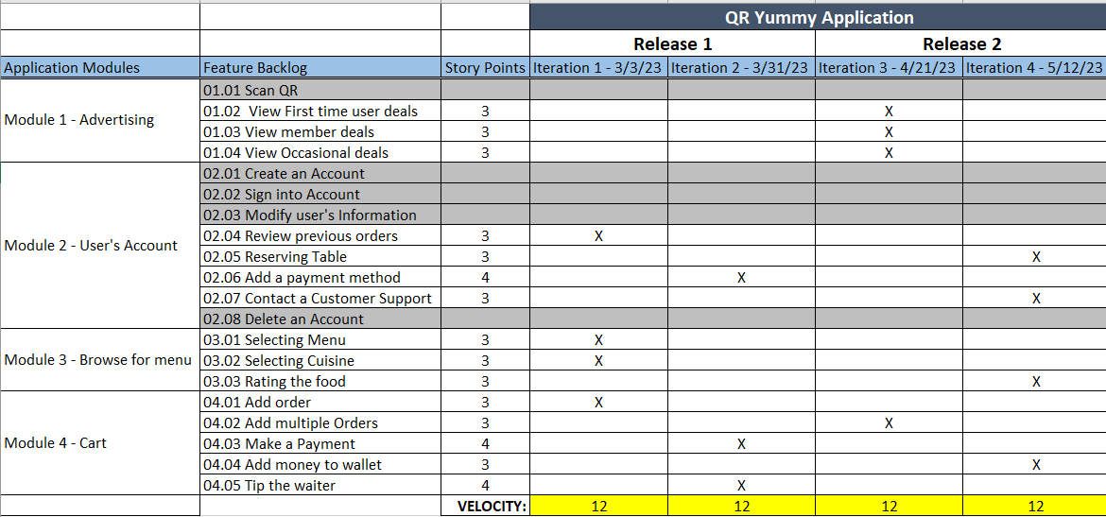
R1: RoadMap - Zubair

Slide 3
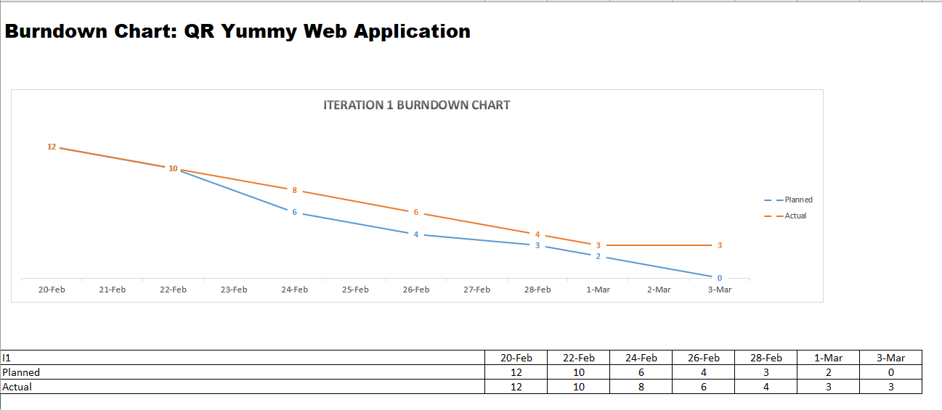
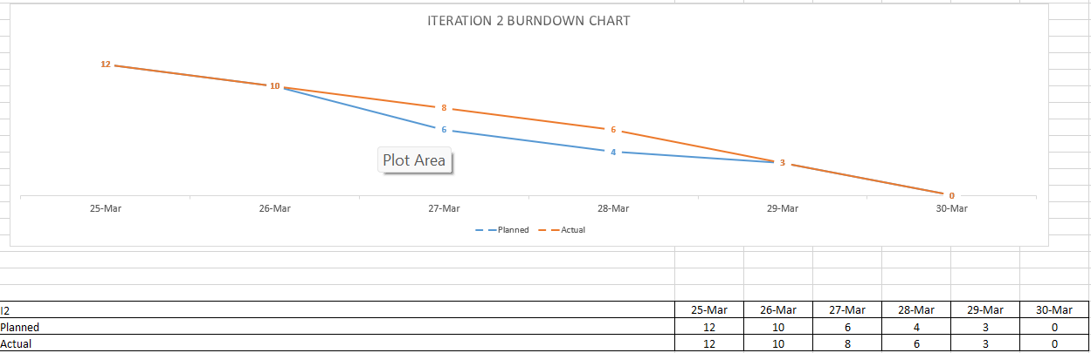
R1: Burn-down Chart - Zubair

Slide 4
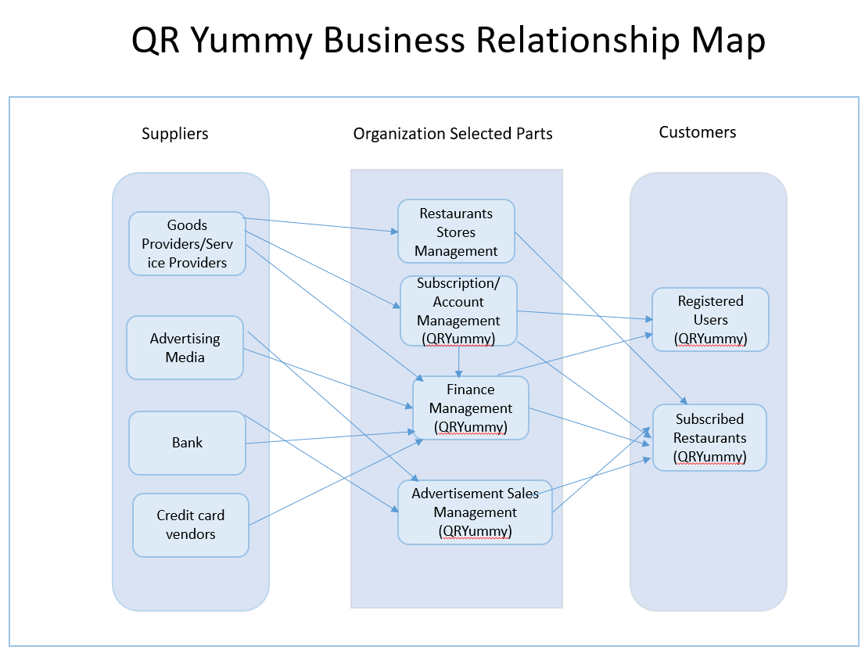
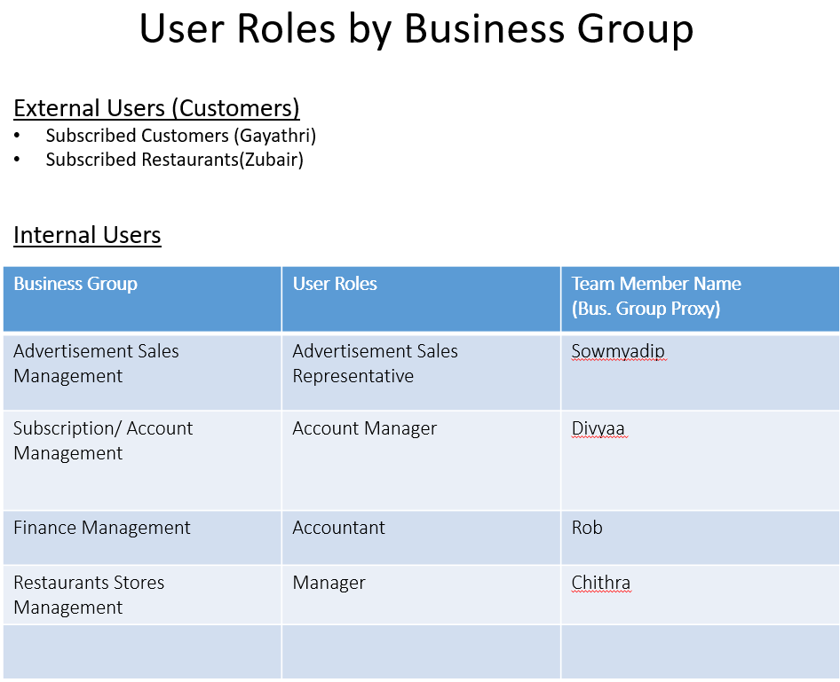
R1: BRM Diagram, User Roles - Divyaa

Slide 5
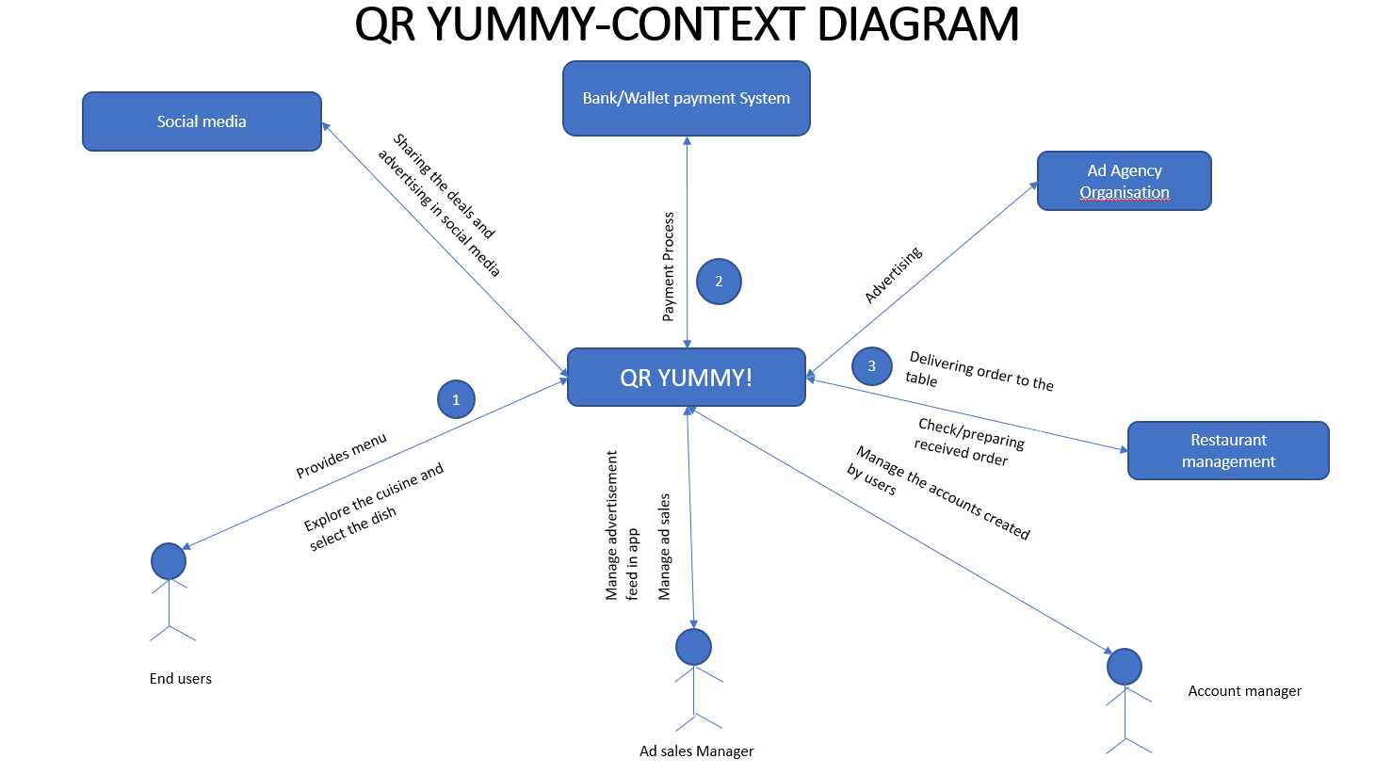
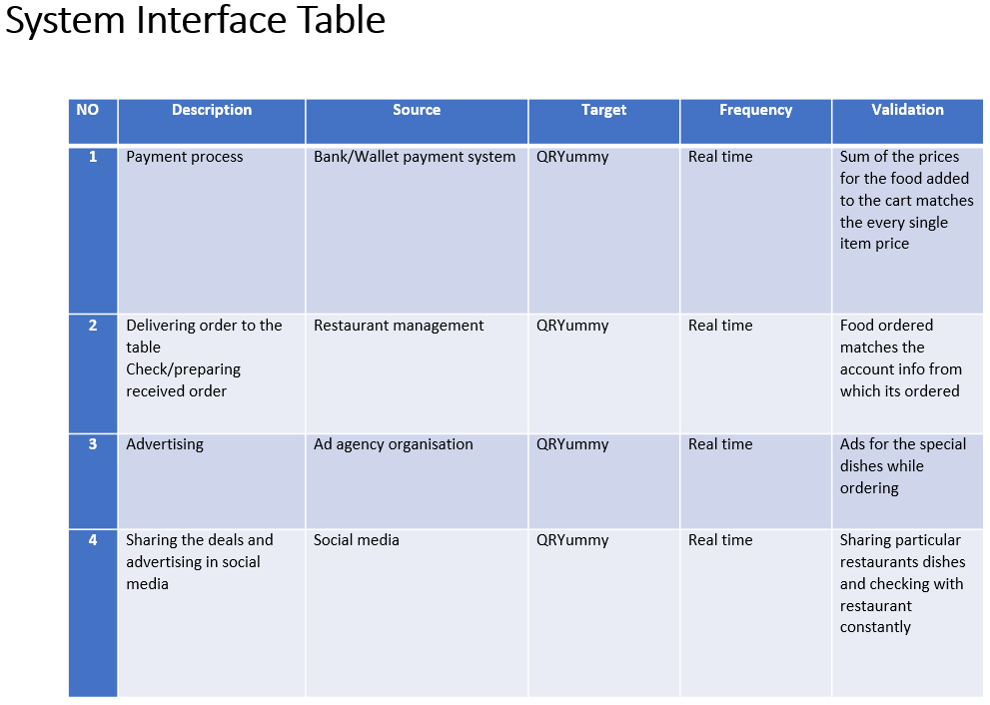
R1: Context Diagram, System Interface Table - Divyaa

Slide 6
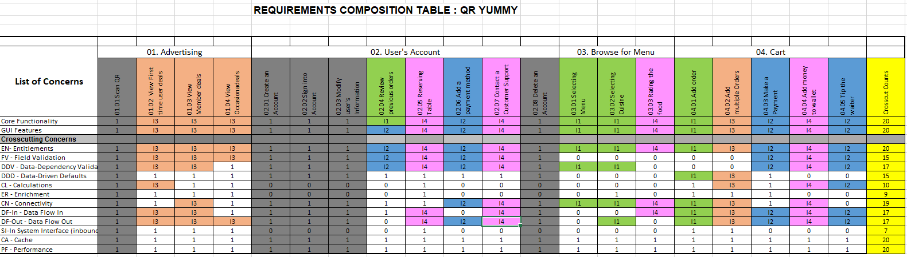
R1: RCT - Planning I1,I2 - Chithra

Slide 7
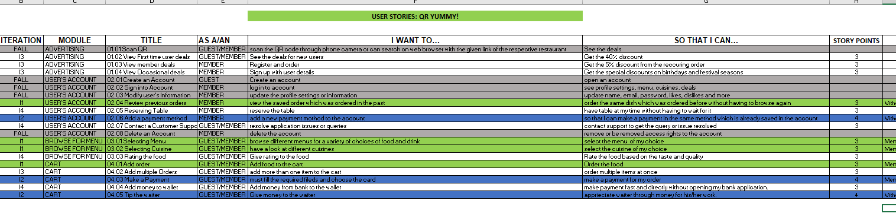
R1: User Stories (I1, I2) - Chithra

Slide 8
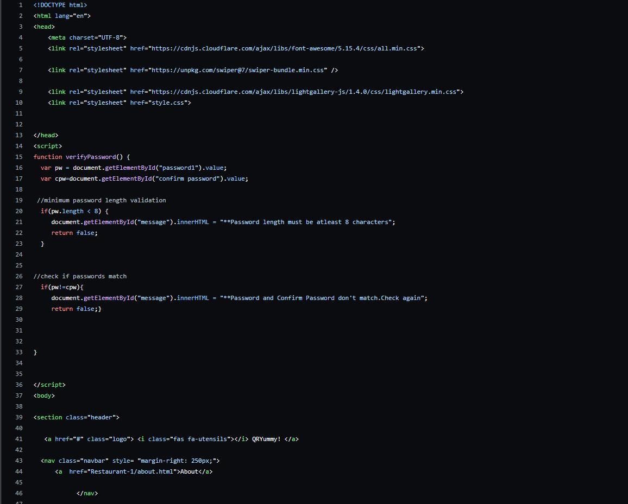
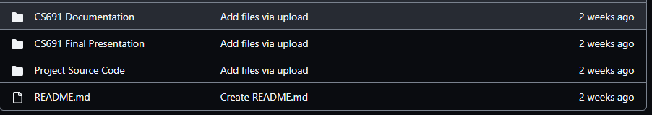
R1: Source Code/GitHub Repository - Soumyadip Chatterjee
https://github.com/ralibert727/QR-Yummy

Slide 9
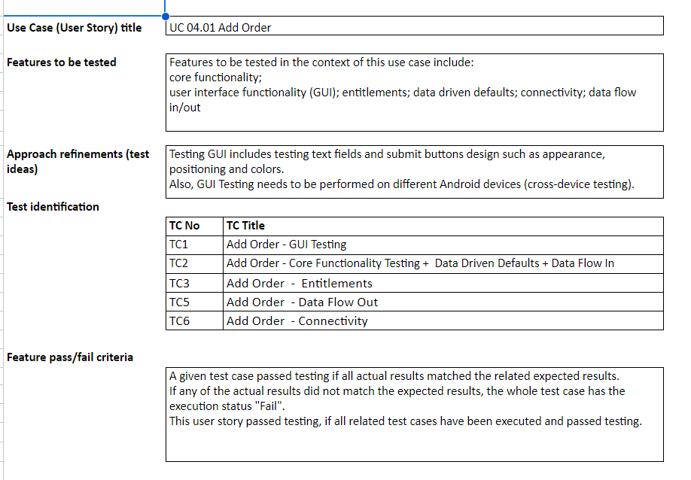
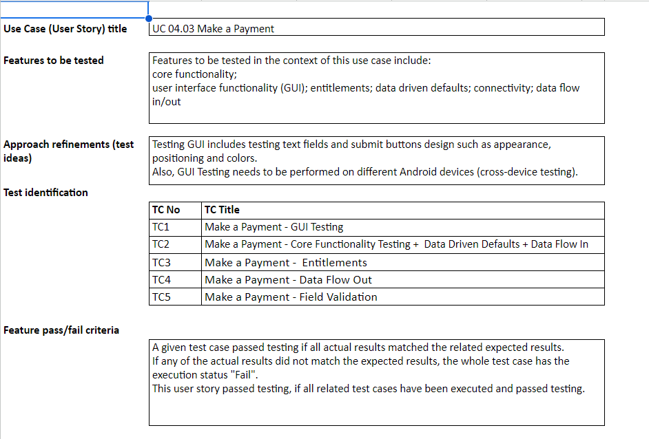
R1: Acceptance Tests (I1,I2) - Rob

Slide 10
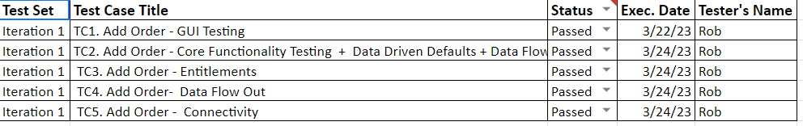
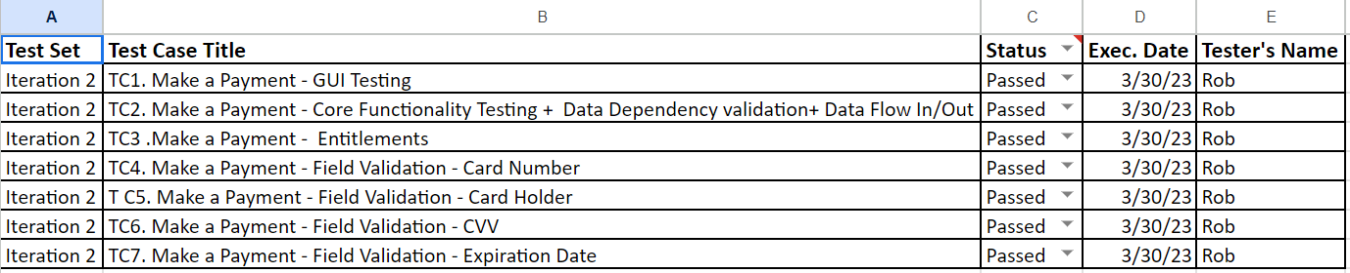
R1: Test Execution Log (I1,I2) - Rob

Slide 11
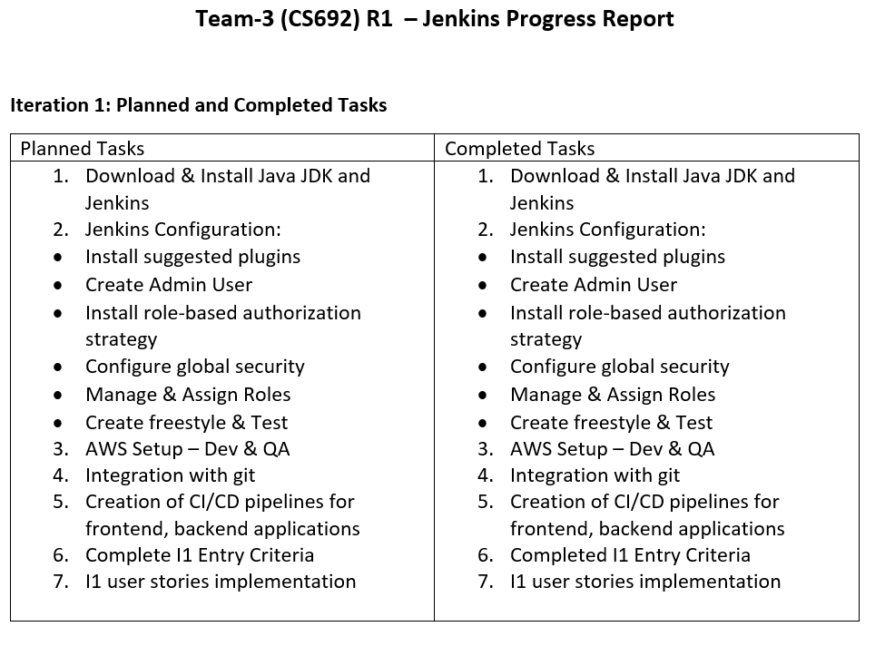
R1: Jenkins Progress Report - Soumyadip

Slide 12
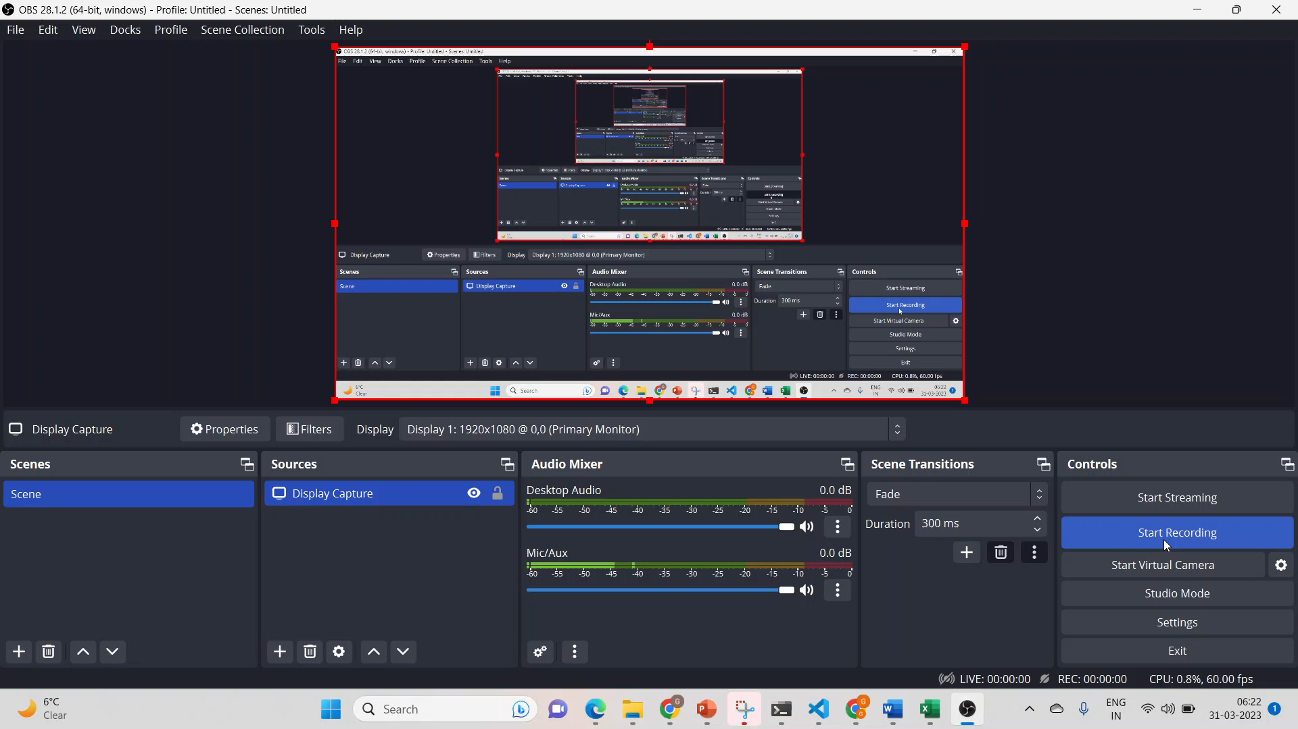
R1: App Demo - Gayathri

